Slide 1
Arduino Workshop #4
USB and Serial Communication
Notes:
24 – Arduino Uno
24 – USB cable
24 – LED
24 – RGB LED (common cathode)
24 – 150 Ω resistor
72 – 220 kΩ resistor
48 – 10 kΩ resistor
24 – Jumper wire sets
24 – Breadboards
24 – Potentiometers

Slide 2
PowerPoint and Code
Github.com/EELabMan
Go To Repositories and find Arduino 4 Communications

Slide 3
Understanding the Arduino’s Serial Communication Capabilities
Different Arduino boards offer different serial implementations
Serial vs USB
Serial ports (RS-232) have largely been replaced by the USB standard
The ATMega328P has one serial hardware port
Includes a transmit (TX) and receive (RX) pin that can be accessed on digital pin 0 and 1
These pins are multiplexed (connected to more than one function)
Not directly compatible with each other
Two options to connect them
Use a secondary integrated Circuit (IC) that facilitates this connection
Type of interface present on the uno
Use a microcontroller that has a usb controller built in
Arduino Leonardo’s 32U4 MCU for example

Slide 4
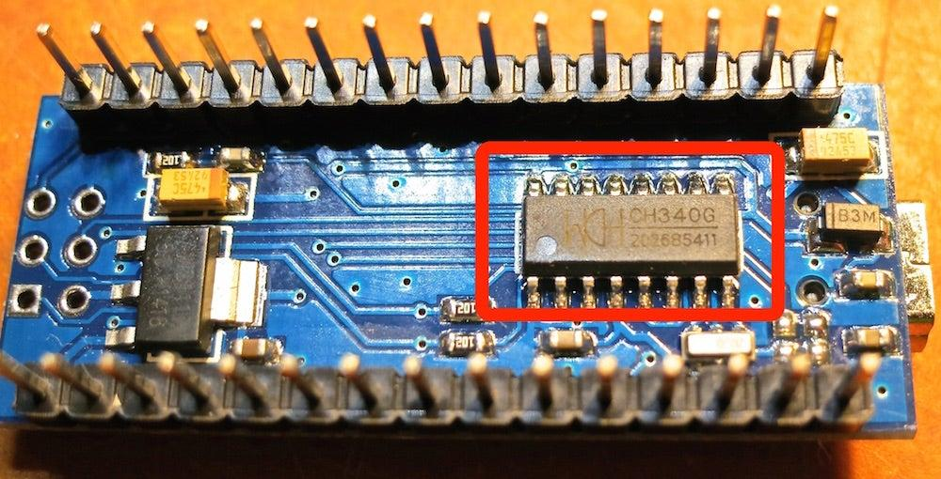
Arduino boards w/ internal (or external) FTDI USB-to-Serial Converters
As explained Arduino boards (and their clones) use a secondary IC to facilitate USB-to-Serial conversion
The “FTDI” chip is popular chip with that sole function (the Arduino Nano has an integrated FTDI chip)

Slide 5
Other options
Removable FTDI programmers
Great if you dont need to use USB to connect to a computer
Reduces cost over multiple devices
Smaller form factor of finished product
Use a board with a secondary USB-capapble ATMEga MCU emulating serial converter
Arduino uno was the first to introduce the use of ID to handle USB to serial
Located on the uno directly behind the USB-B receptacle
16U2 on newer chips

Slide 6
Listening to the Arduino
The most common serial function is to print to the computer terminal
You have already done this in several previous sessions
The process is the same for all arduinos
To print data, you utalize 3 functions
Serial.begin(“baud_rate”)
Must be called once the program starts
In the setup()
Serial.print(“message”)
Serial.println(“message”)
Adds a carriage return (so the next thing printed is on the next line)
“Baud_rate” and “message” are variables you define

Slide 7
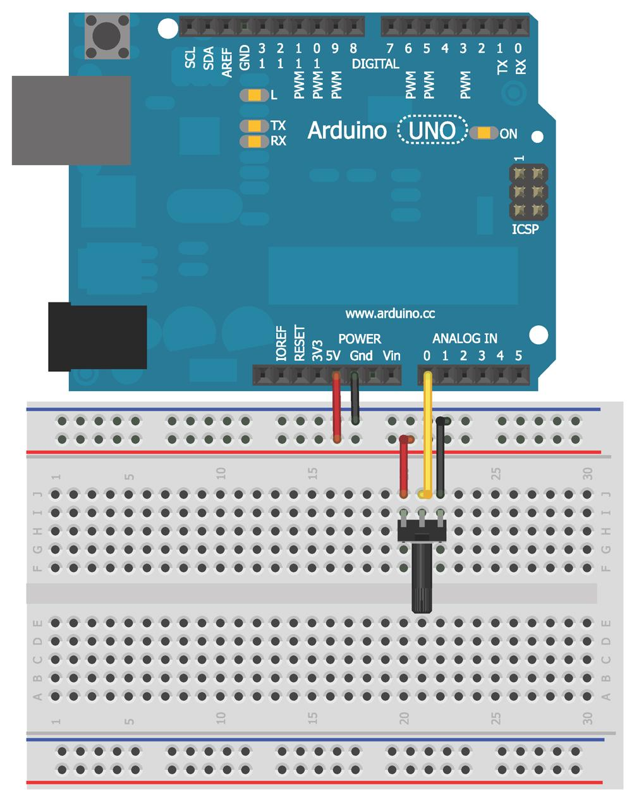
Hands on is a better teacher here
Wire a potentiometer as shown
We will use this to read the value and display it both “raw” and as a percentage

Slide 8
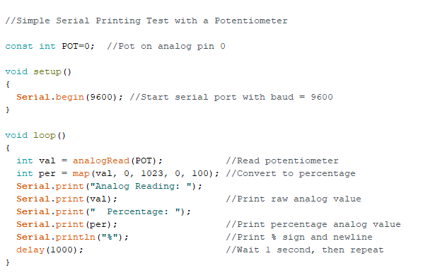
The code
Download pot.ino from github and upload to the Uno.
Ensure the baud rate is set to 9600 on the arduino IDE
You should see the values printing out once per second as you turn the potentiometer

Slide 9
Special characters
You can format the serial data to be more useful
Special characters are indicated with a backslash (\)
Two of great interest to us
\n
Insert a new line in a string
\t
Insert a tab spacing in a string

Slide 10
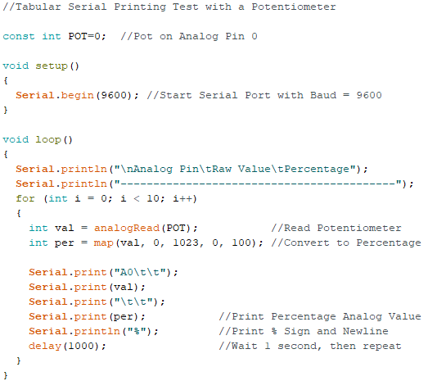
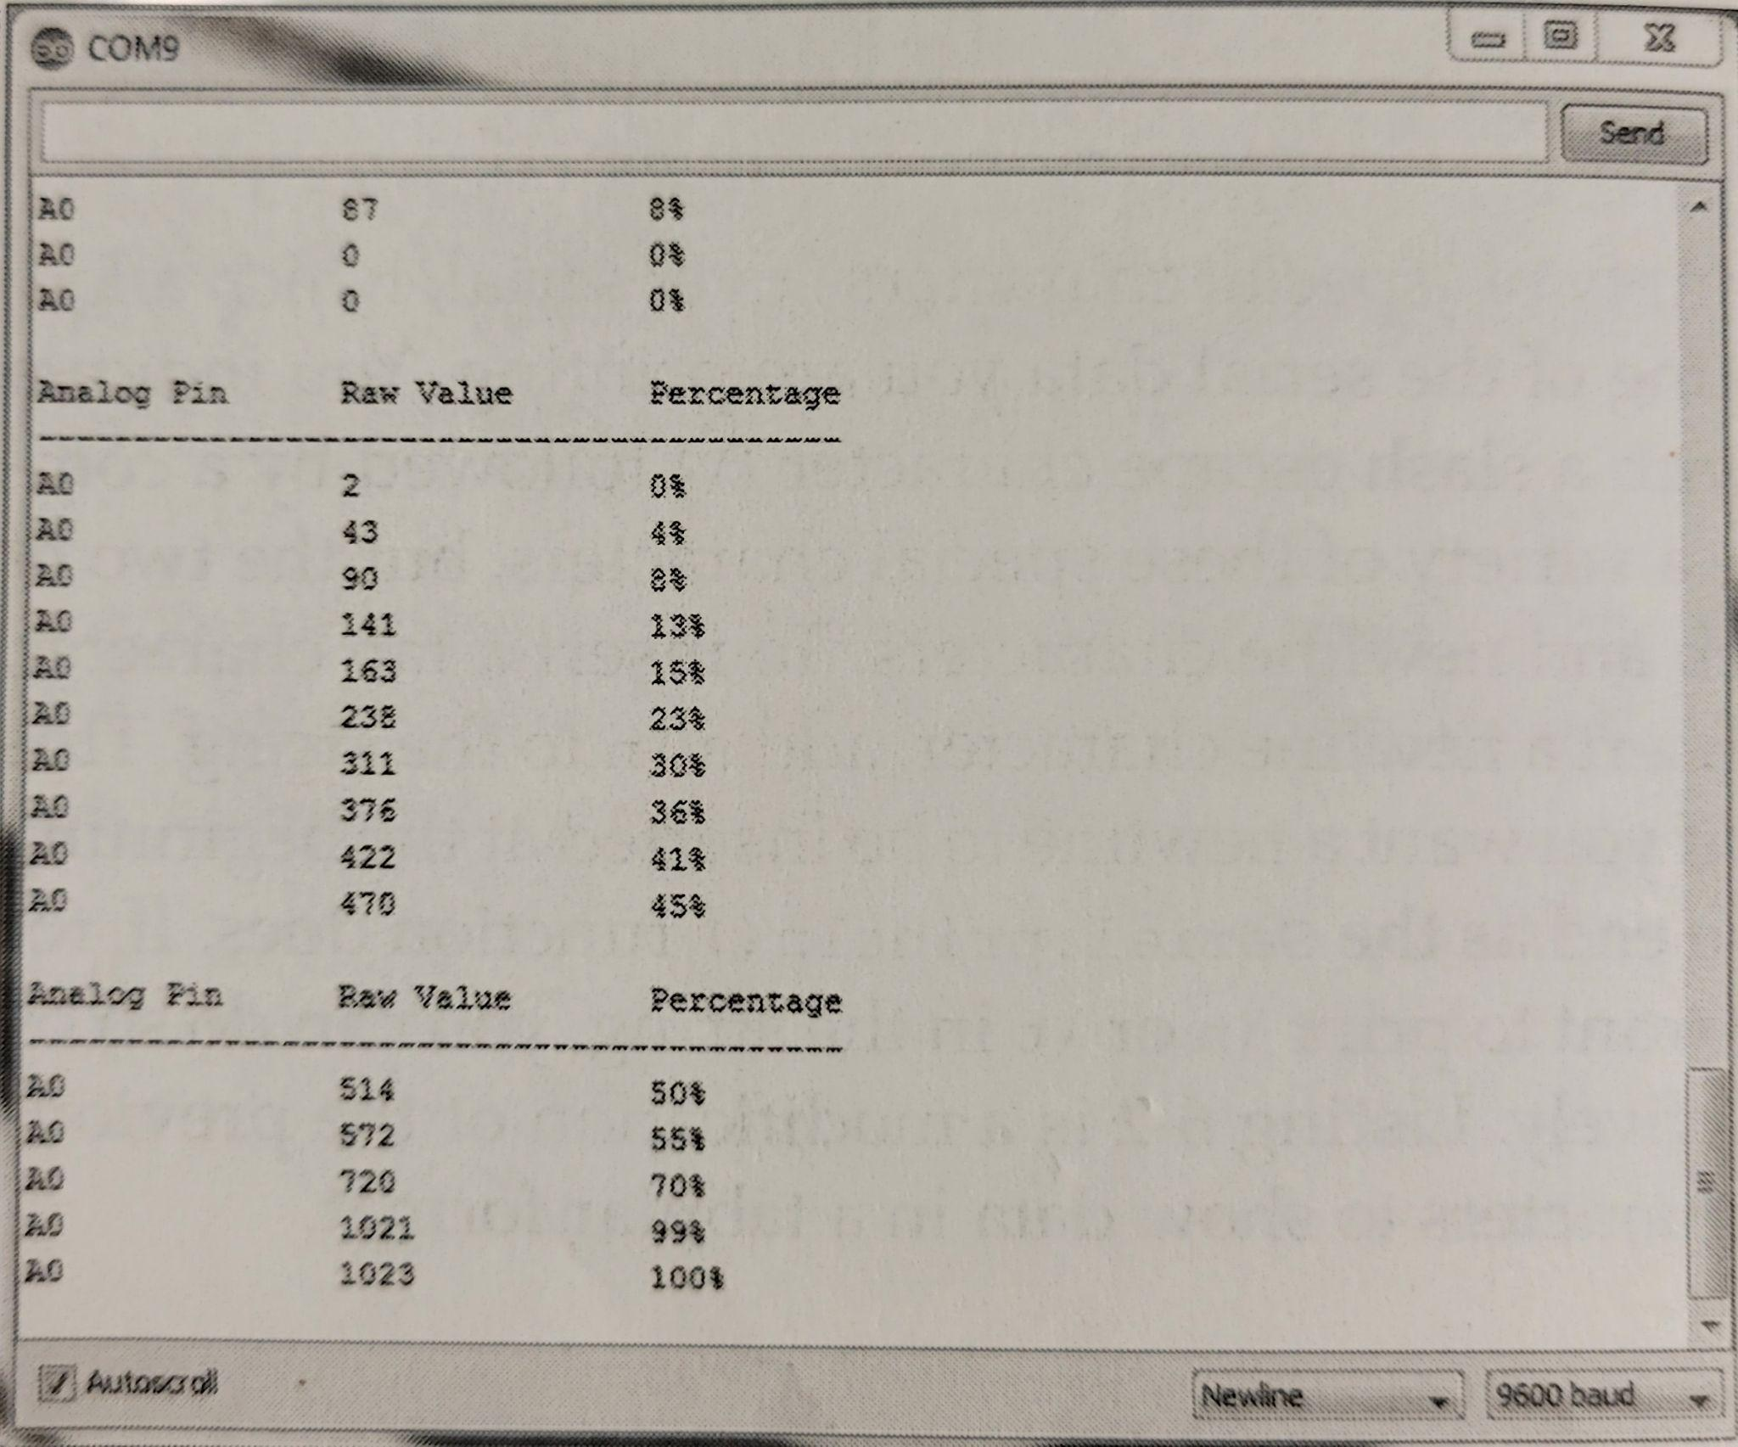
Download pot_tabular form github.
The code
What you should see

Slide 11
Changing data type representations
Serial.print() and Serial.prinln()
Are intelligent when it comes to printing data
You can change the format of the data presented
Hexadecimal
Octal
Binary
Decimal-coded ASCII is the default
Data type | Example code | Serial output
Decimal | Serial.println(23); | 23
Hexadecimal | Serial.println(23, HEX); | 17
Octal | Serial.println(23, OCT); | 27
Binary | Serial.println(23, BIN); | 00010111

Slide 12
Talking to the Arduino
No conversation should be “one sided”
You may have noticed the Arduino IDE has a text entry field at the top
Take a look at yours if you haven't seen it
First make sure the drop-down is set to “Newline”
The drop down menu determines what (if anything) you append to the end of your code when sent to the arduino
The serial monitor send the whole command string at one time
When you press enter (or the send button)
At the baud rate you specify
In contrast to other terminals
PuTTy
Sends characters as you type them

Slide 13
Things to note
You will learn how to send multiple commands at once and how to build a Graphical User Interface or GUI to send commands
The serial port does have a buffer
You can send several bytes at once and they will be queued and processed in order of the content of your sketch
No need to worry about being faster than your loop time
If you send to much data and overflow the buffer some information will be lost

Slide 14
Arduino - echo incoming data
Simplest thing to do is have the arduino echo what you send
You need two new commands for this
Serial.availible()
Returns the number of bytes stored in the incoming buffer
Whenever its more than 0 you will read the characters and echo them back to the computer
Serial.read()
Reads and returns the next character that is available in the buffer
Note:
Serial.read() only retuirns 1 byte, so you need to call it for as long as Serial.availible() is greater than 0
Serial.read() removes the read byte from the buffer as it reads it

Slide 15
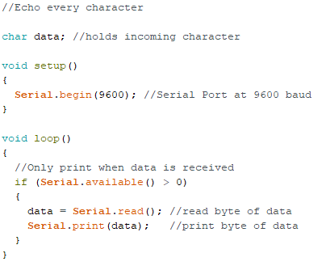
Download echo.ino from github
Launch the serial
Type anything you want
Press send
Whatever you typed should be echoed back and displayed in the serial monitor
Note:
You should already have selected to append a “newline”
This is why Serial.print() not Serial.println() is used

Slide 16
Char vs Ints
When you send a alphanumeric character via the serial monitor, you arent actually passing a “5” or an “A”.
You are sending a byte that the computer interprets as a character
Serial communication uses ASCII character sets to represent all letters, numbers, symbols, and special commands
ASCII is a 7-bit set (128 unique characters or commands)
Data therefore when read must be read as a char type
If you modify the code to declare data as an int
Sending “5” would return “53”
53 is the ASCII representation of 5

Slide 17
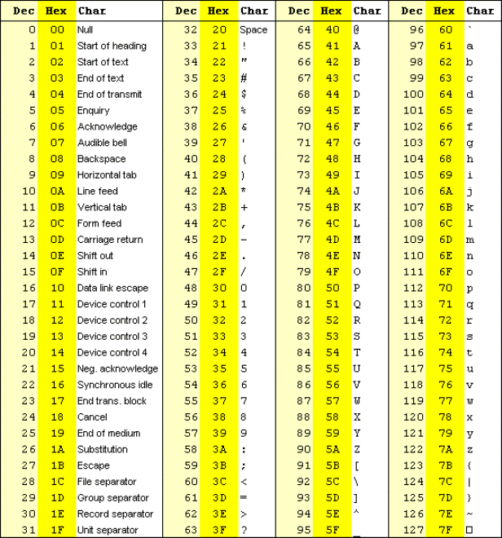
An ASCII table for reference
If you have ever seen (or read) “The Martian”, ASCII is how NASA “talked” to Mark on Mars (using camera angles as hexadecimal)
Type ALT + 234 into google or Word
This is part of the extended ASCII code.

Slide 18
So how do you send numeric values?
Lets say you want to turn an LED on when you send 1
You could compare the character value like this
if(Serial.read() == ’1’)
Single quotes around the 1 means it should be treated as a char
You could also treat each byte as an incoming integer
Int val = Serial.read() - ‘0’
Doesnt work very well as numbers greater than 9 are double digits
Arduino IDE includes a function to parse integers from data streams
parseInt()

Slide 19
Send a character to control an LED
Before we parse large strings of multiple digits let's start by writing a sketch to turn on an LED when we send it the value 1 and turn off when we send it 0

Slide 20
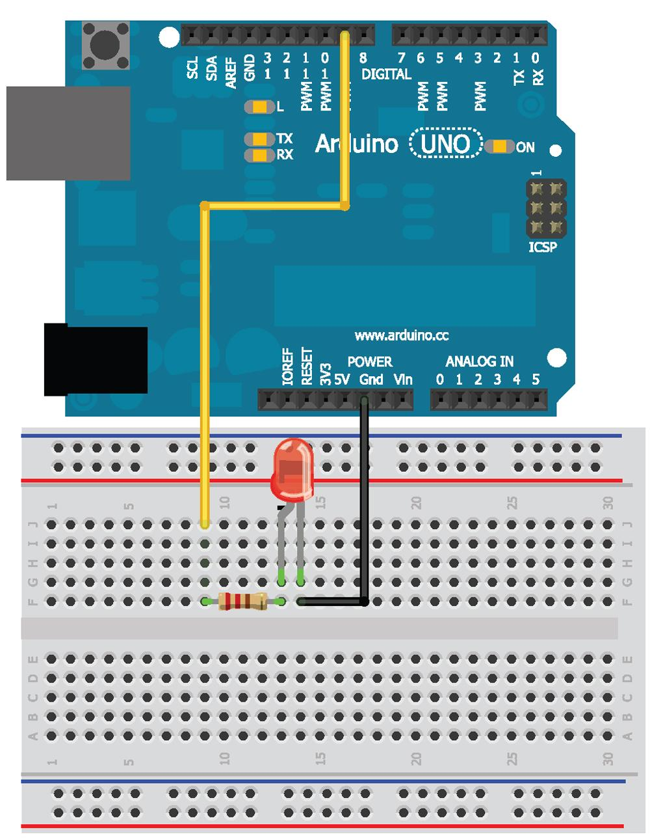
Wire Diagram

Slide 21
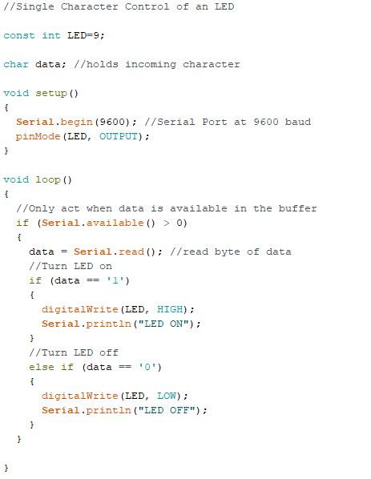
Download single_char_control.ino
Notice
else if used instead of else
This clears the buffer
Serial.read() will
read the newline
see its not a ‘1’ or ‘0’
Overwrite it the next time serial.read() is called
else() would
Turn off the LED if ‘0’ or ‘\n’ were used
It would turn on with ‘1’ and immediately turn off

Slide 22
Sending lists of values
One color led is fine and good but what if I want to control a RGB LED?
I would need to send three separate 8-bit values (0-225) to set the brightness of each color
white -- 255,255,255
Green -- 0,255,0
Etc.
Our sketch needs to
differentiate between numbers and commas
Turn thos sequence into int and pass it to analogWrite()
Handle the fact values could be 1,2 or 3 digits loing
We will use the function
Serial.parseInt()

Slide 23
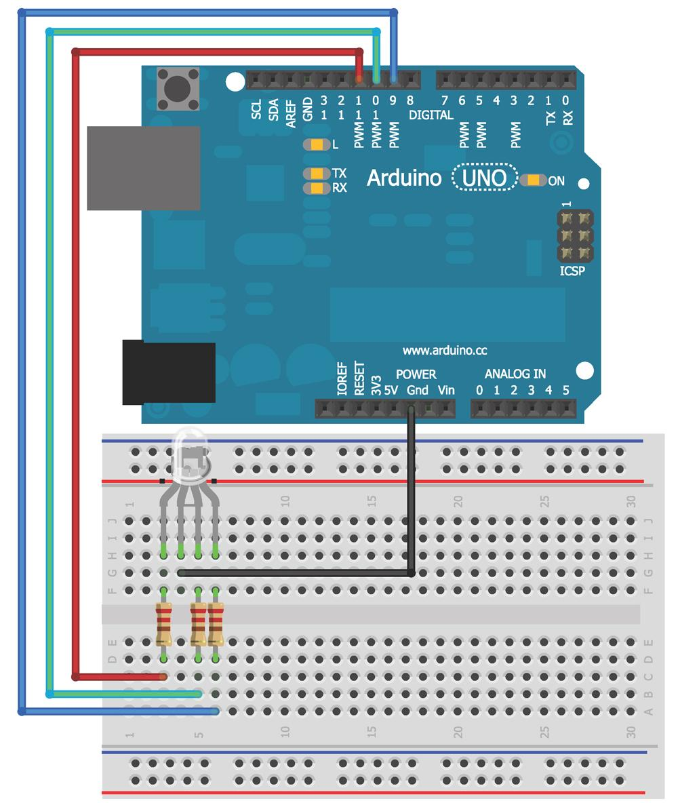
Wire up a RGB led

Slide 24
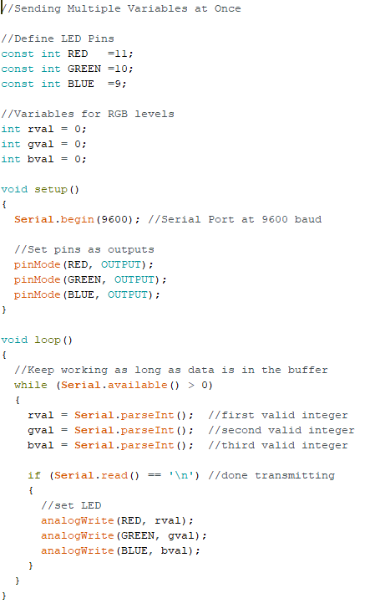
Download list_control.ino
What is it doing?
The program looks for 3 integer values
When a new line is detected
The values it read are used to set the brightness
To use this
Open the serial monitor and enter 3 values (0 to 255) separated by commas
Try different combos to see what colors you make

Slide 25
User Interface

Slide 26
Talking to the desktop
Eventually you will get bored with the serial monitor
Just about any desktop programming language has a library that allow it to interface with the serial port on your computer
We will use Processing as our language of choice
The arduino language is based on Processing
Other languages that have well documented serial communications libraries
Python
PHP
Visual Basic
C
A computer programming adage
It takes a year to learn your first computer language and a month to learn your second
If this is the first language, it may take some practice but you will get good… dont fear
We will first learn how to read the serial data in Processing
Then we will learn how to use Processing to create a simple graphical user interface (GUI) to send commands to the arduino

Slide 27
Installing Processing
It should be installed on the computers for this session, but if you want to install it on your own device
https://processing.org/download?processing
Download the compressed file from the link above
Unzip it to your preferred location
Run the application
When you start it it looks like the Arduino IDE (not a coincident as Arduino is based on Processing)

Slide 28
For our first experiment
We are going to use a potentiometer to control the color of the window on the computer

Slide 29
Wire up the arduino

Slide 30
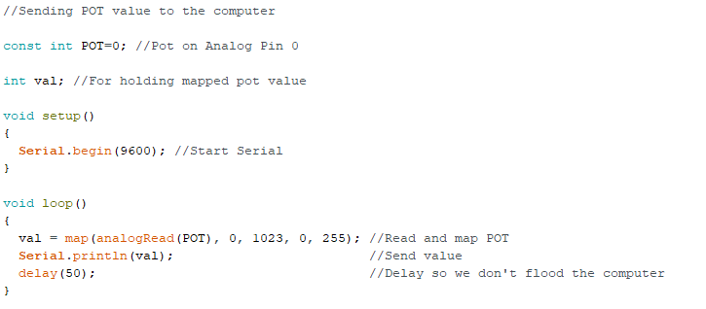
The arduino code
Download arduino_read_pot.ino to upload to the Arduino
Download processing_display_color.pde to run in Processing.

Slide 31
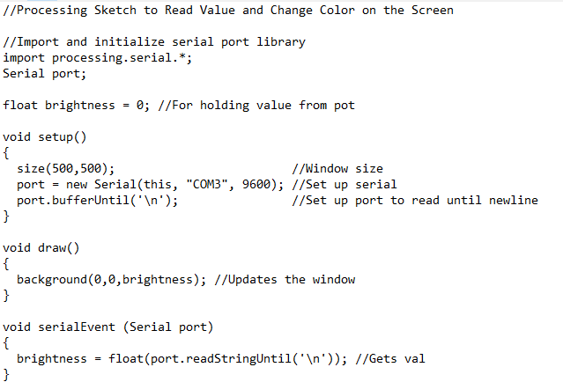
Now to Processing
Things to note:
Replace “com 3” with the name from the arduino IDE port
After you load the code into your Processing IDE and set the serial port properly
CLOSE ARDUINO IDE
Only one program can access the port at a time
Click run - you should see a small window pop up and turn from black to blue as you turn the potentiometer

Slide 32
Send data from Processing to Arduino
The next obvious step is to send data from processing to the arduino
Wire up a RGB LED
Load the same program from earlier
Instead of sending a string of three values we will use a “color picker”
In the code for Processing remember to change the port as needed
The Processing sketch atom,aticall loads a collateral file from “data”
Download the hsv.jpg and place it in the “data” file in the processing directory
The image in the data file will serve as the color selector

Slide 33
Wire the arduino

Slide 34
The Arduino code
Download list_control.ino and upload it to the Uno. It’s in the processing_control_RGB folder

Slide 35
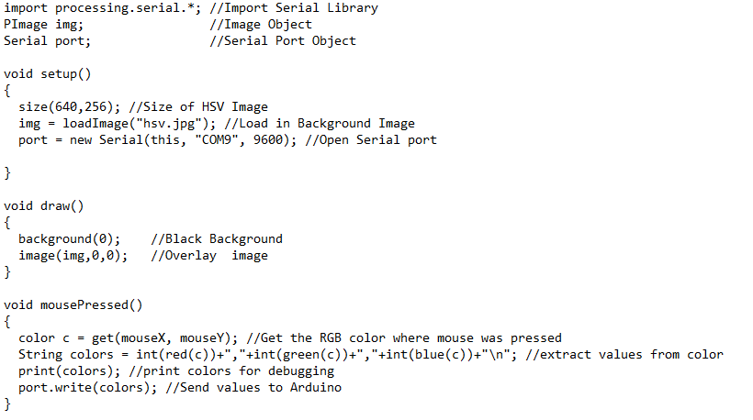
The Processing Code
Download processing_control_RGB.pde

Slide 36
What you should see
You should see a pop up of colors that when selected change the LED to that color
The serial console will also display the commands being sent (to help with de bugging)
How is this working?
The serial library is imported and an object called port is created
A PImage object called img is also created
This displays the background image
In setup()
The serial port is initialized
The display window is set to the size of the image
The image is imported

Slide 37
How is it working?
The serial library is imported and an object called port is created
A PImage object called img is also created
This displays the background image
In setup()
The serial port is initialized
The display window is set to the size of the image
The image is imported
draw()
Image is loaded with image(img,0,0)
Img is the image you want to draw on
0,0 is the starting coordinates of the image (top left)
Everytime the mouse is pressed
mousePressed() is called
The color of the pixel chosen is saved as a color object named c
get() tells the mouse was (x and y coordinates)
This is converted into a string that is sent to the Arduino and converted to RGB as earlier

Slide 38
Click around the image and watch the LED change

Slide 39
Stay tuned
Arduino 5 will cover Multiplexers.
We’ll connect 8 LED’s and control them with 4 wires from the Arduino!

